Slide 1
Advanced Deep Learning
Lecture 9/10

Slide 2
Classic NLP Tasks
Classification
Translation
Generation

Slide 3
Classic Image Tasks
Classification
Segmentation
Generation

Slide 4
Outline of the class
Introduction to Deep Learning
PyTorch
Optimizers review. Types of Machine Learning problems and their losses.
Layers Types 1 (linear: width vs depth)
Layers Types 2 (conv, pooling & softmax)
Architectures (RNN) & Transfer Learning
Practical Exercises and hyperparameter optimization
Attention. Transformers.
Text Generation. Low-Rank Adaptation of Large Language Models
Exam
Notes:
Transformers => NLP. Voir Transformers comme RNN en mieux.
Stable Diffusion => Image Generation. Voir Stable Diffusion comme GANs en mieux.

Slide 5
RNNs
https://pytorch.org/docs/stable/generated/torch.nn.RNN.html

Slide 6












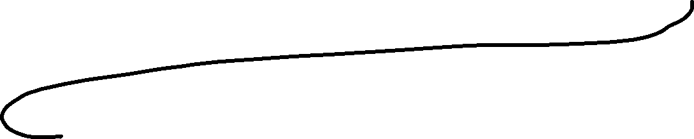









Sequence to sequence tasks (RNN)
Notes:
On n’a jamais fait de seq2seq tasks donc regardons ce que ça donne en RNN déjà (ce n’est pas la seule manière de faire !). J’ai oublié les flèches mais on passe le dernier mot généré en plus du hidden state dans le décodeur.

Slide 7






Sequence to sequence tasks (RNN)
How do we train a seq2seq RNN?
We input a sentence that needs to be translated.
We encode it sequentially.
Then the first decoder outputs the first word with probabilities.
We do a gradient descent by comparing them with the actual word expected.
Then we input to the second decoder the hidden state and it outputs the second word with probabilities.
We do another gradient descent.
But what if the first hidden state was wrong because it failed to output the right word?
Then this second gradient descent is meaningless?

Slide 8
Sequence to sequence tasks (RNN)
How do I know when I don't need to output anything?
You can't just "copy" the size of the input sequence (I’ve got a little bit of money > J’ai un peu d’argent).
In text generation settings, the input sequence is even less relevant.
-> solution: extend vocabulary with a "stop word".

Slide 9











Sequence to sequence tasks (RNN)
Notes:
First problem of RNNs. Long-range dependencies.

Slide 10
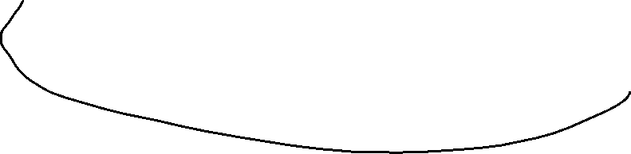
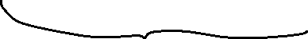
Sequence to sequence tasks
Boston is a historic city located in Massachusetts, known for its prestigious universities, rich culture, and vibrant sports scene (Football, Basketball, Tennis, Golf, Swimming, Boxing, Volleyball, Rowing, Rock Climbing, Gymnastics, …). It is also the [largest city in New England, with a population of over 700,000 people].

Slide 11
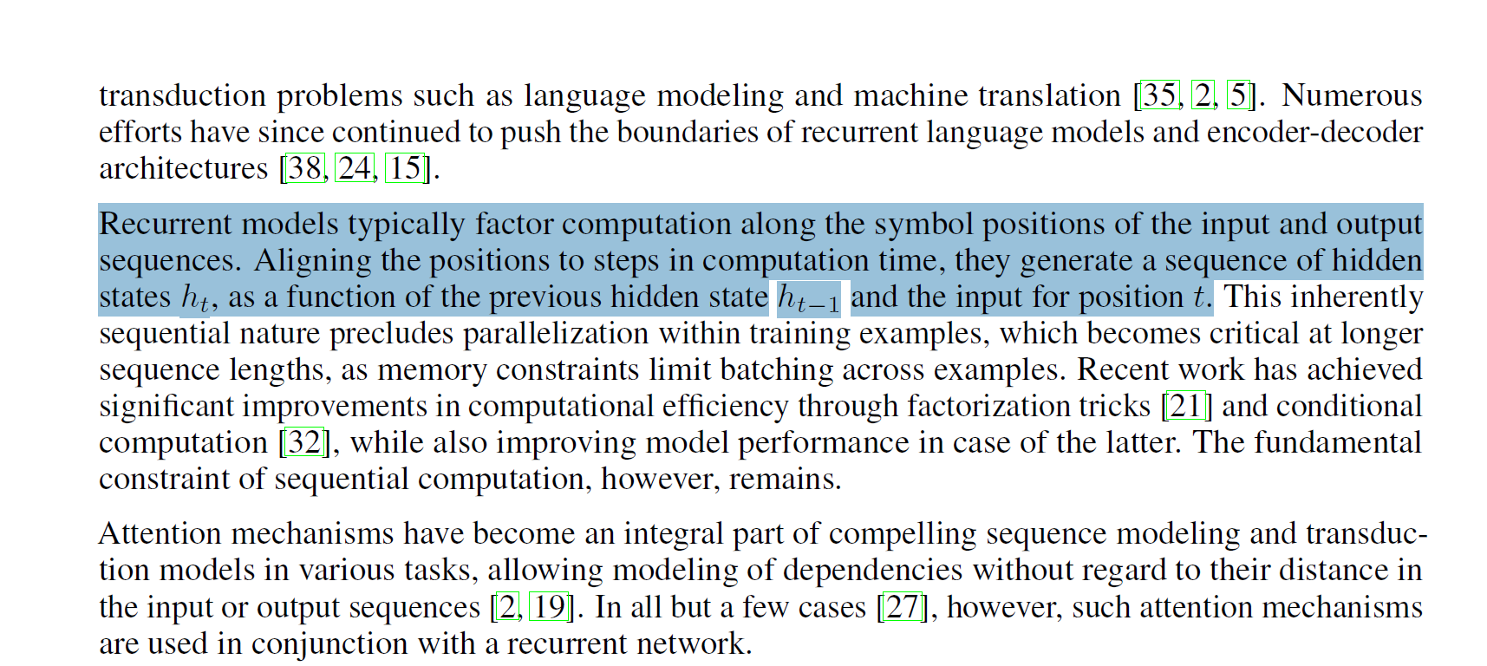
Sequence to sequence tasks
Notes:
Second problem of RNNs

Slide 12
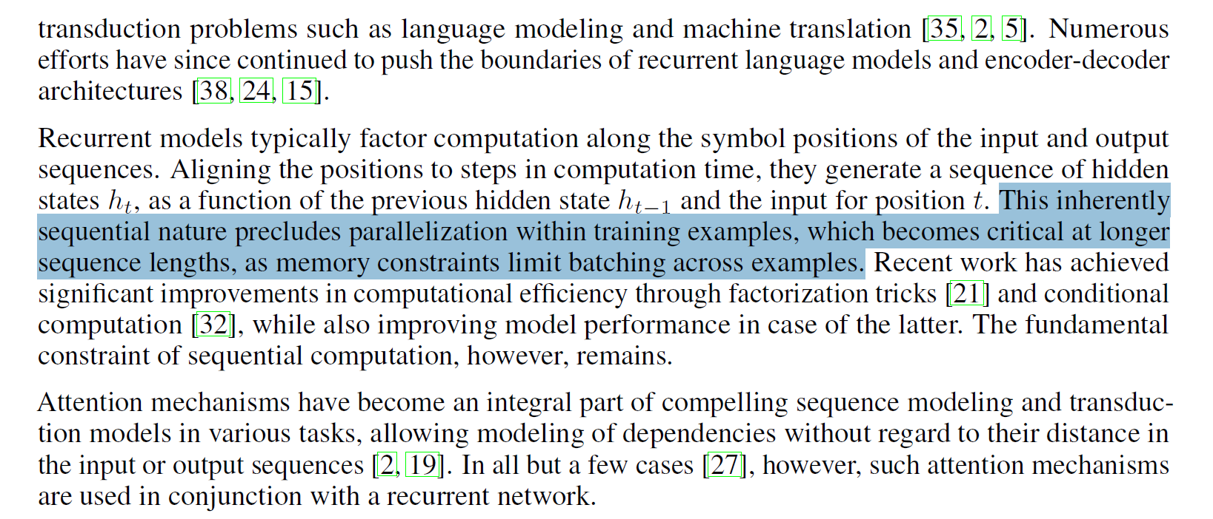
Sequence to sequence tasks

Slide 13
Sequence to sequence tasks (RNN)
Notes:
To address the second problem, we could use hidden states selection to pass to the next decoder, this is attention.

Slide 14
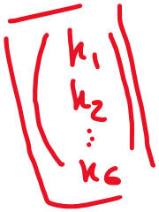











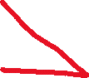





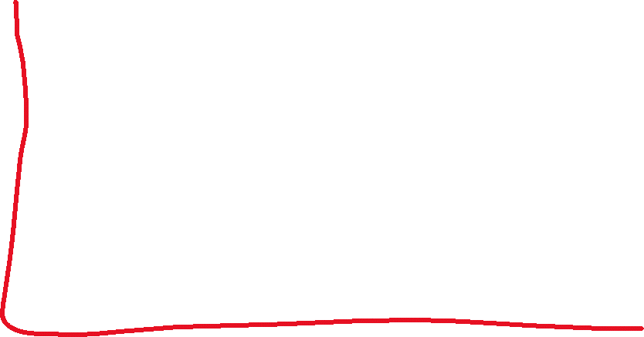





Sequence to sequence tasks

Slide 15
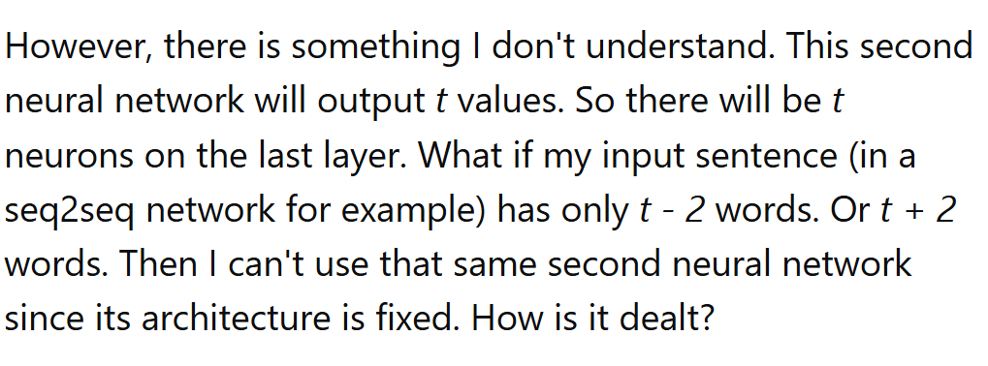
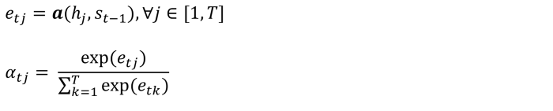
Sequence to sequence tasks

Slide 16
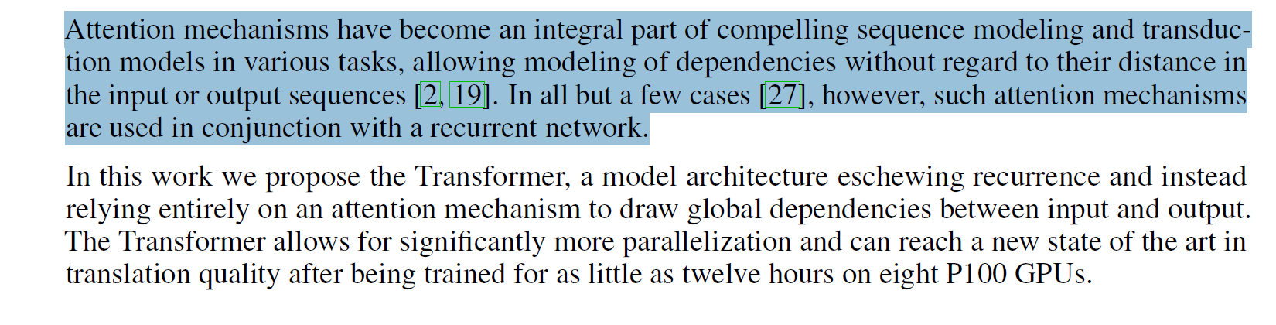
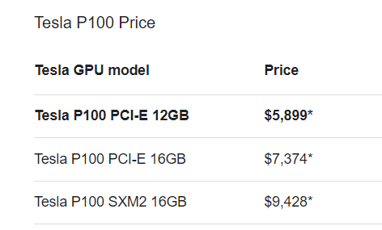

Sequence to sequence tasks
Notes:
Donc attention c’est très cool MAIS le problème de parallélisation compliquée reste une grosse problématique. A la rescousse les transformers (ça reste cher).

Slide 17
Attention is all you need
"Attention is All You Need" is a paper published by Google researchers in 2017, which introduced the Transformer model for sequence-to-sequence tasks.
The paper proposes an alternative to recurrent neural networks (RNNs)
The Transformer model consists of an encoder and a decoder, both composed of stacked layers of self-attention and feedforward neural networks.
Self-attention allows the model to attend to different parts of the input sequence when predicting each output token, without requiring sequential processing.
The paper shows that the Transformer achieves state-of-the-art performance on various machine translation tasks, while being faster to train and easier to parallelize than RNN-based models.
The Transformer has since become a popular architecture for a wide range of natural language processing (NLP) tasks, such as language modeling, text classification, and question answering.
The success of the Transformer has also inspired further research into attention-based models for other domains, such as computer vision and speech recognition
Notes:
Paper available on GitHub
Only first two points on this slide, then go next, then we’ll see the rest, no worries

Slide 18
Attention is all you need
"Attention is All You Need" is a paper published by Google researchers in 2017, which introduced the Transformer model for sequence-to-sequence tasks.
The paper proposes an alternative to recurrent neural networks (RNNs)
The Transformer model consists of an encoder and a decoder, both composed of stacked layers of self-attention and feedforward neural networks.
Self-attention allows the model to attend to different parts of the input sequence when predicting each output token, without requiring sequential processing.
The paper shows that the Transformer achieves state-of-the-art performance on various machine translation tasks, while being faster to train and easier to parallelize than RNN-based models.
The Transformer has since become a popular architecture for a wide range of natural language processing (NLP) tasks, such as language modeling, text classification, and question answering.
The success of the Transformer has also inspired further research into attention-based models for other domains, such as computer vision and speech recognition
Notes:
Paper available on GitHub

Slide 19

Attention is all you need
Animations by Michael Phi
Notes:
Vous remarquez qu’à chaque fois on refeed l’input en plus des previous outputs. Et bien que les inputs soient traités maintenant « d’un coup », les outputs sont encore traités séquentiellement, il ne faut pas croire qu’on n’a viré TOUT du RNN. On change comment l’encodeur fonctionne et comme le décodeur interagit avec les inputs encodés. Mais le décodeur fonctionne globalement encore pareil, il génère un mot, puis se souvient de ce qu’il a déjà généré pour générer la suite.
Dans l’animation c’est « continuer » une phrase mais on aurait très bien pu mettre un exemple similaire avec une traduction.

Slide 20
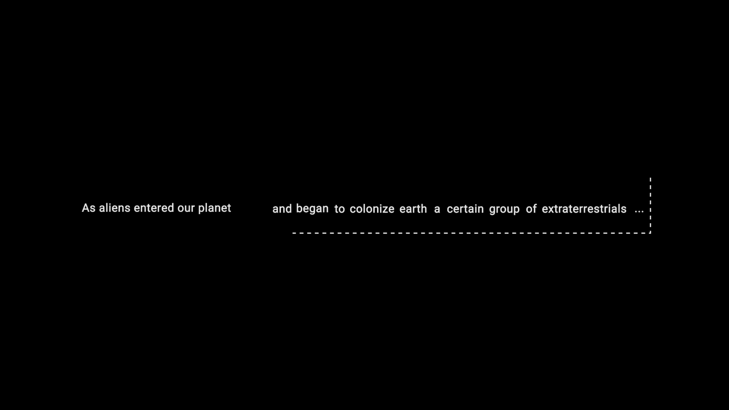
Attention is all you need
Why is refeeding the input at every output produced, useful?
Animations by Michael Phi

Slide 21
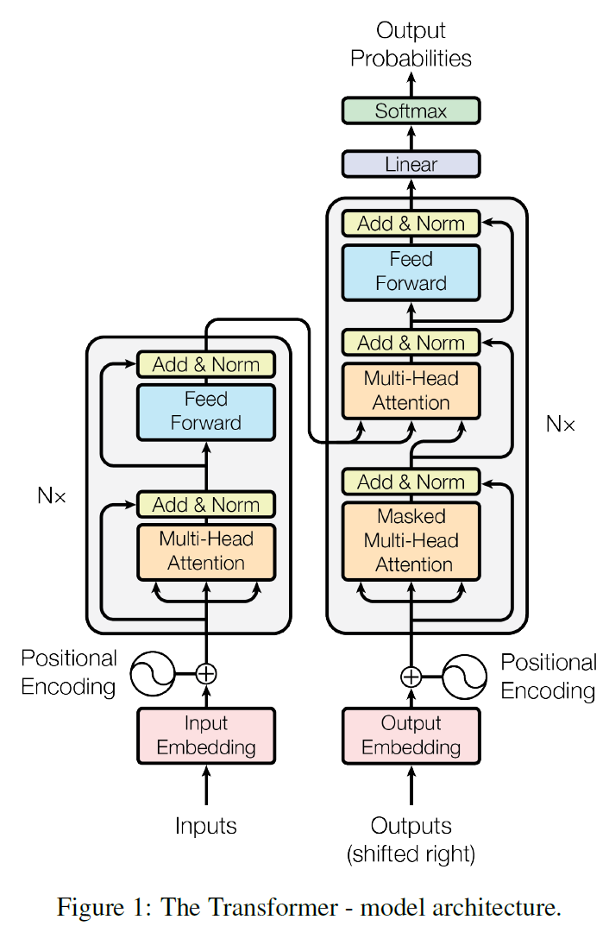
Attention is all you need

Slide 22
Tokenization
TD

Slide 23
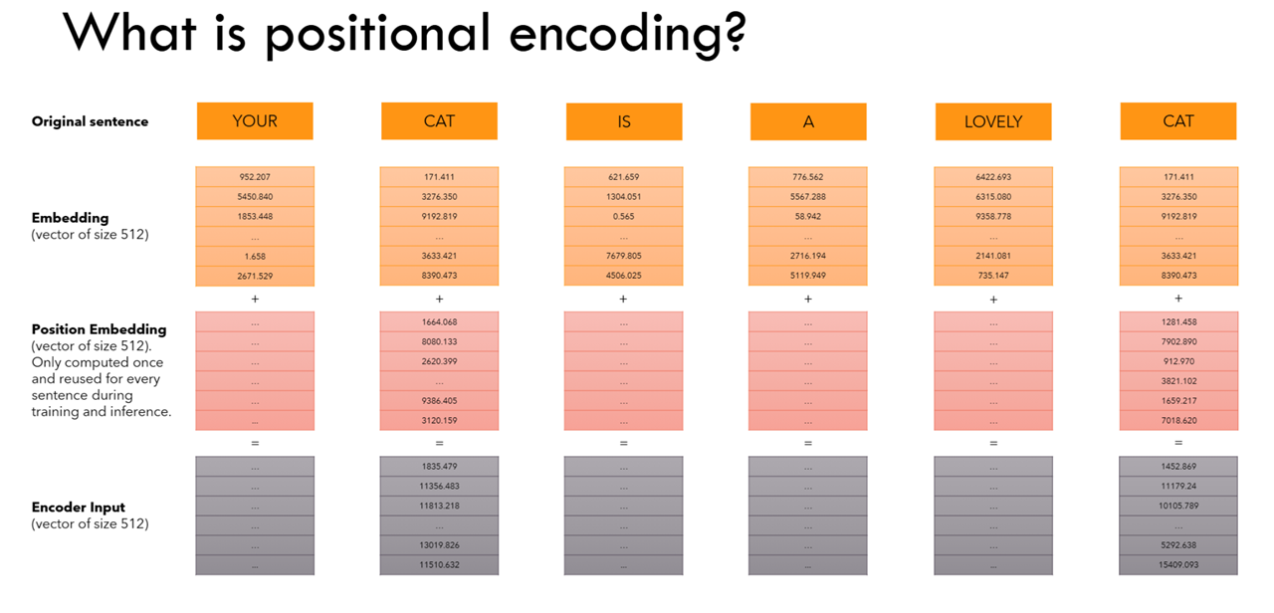

Slide 24
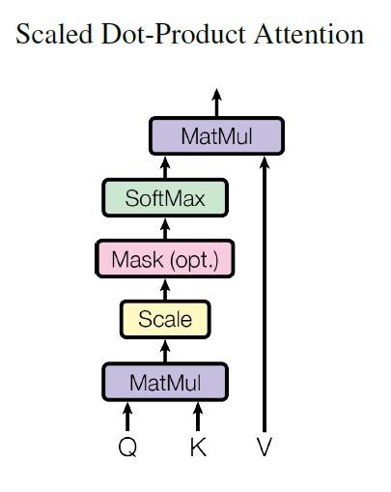
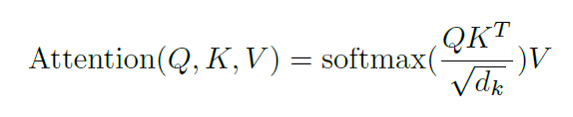




Attention is all you need
Notes:
Regardons comment l’encodeur et le décodeur interagissent. Vous voyez qu’on donne tout l’input d’un coup, mais les outputs ‘un à un’.

Slide 25
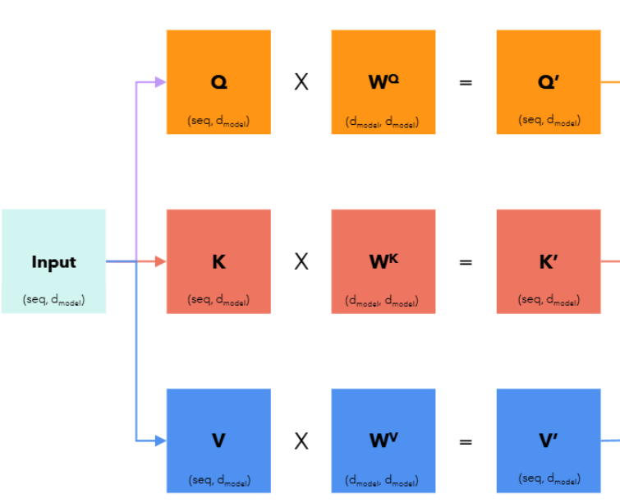
Query Key Value when it’s « against itself »

Slide 26
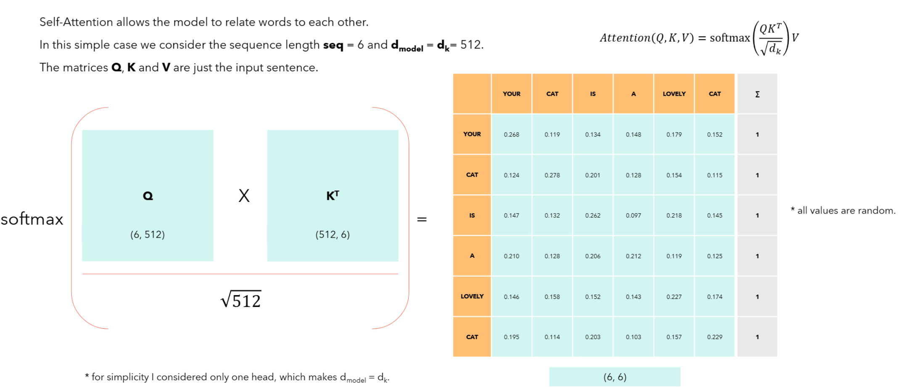
Query Key Value when it’s « against itself »

Slide 27
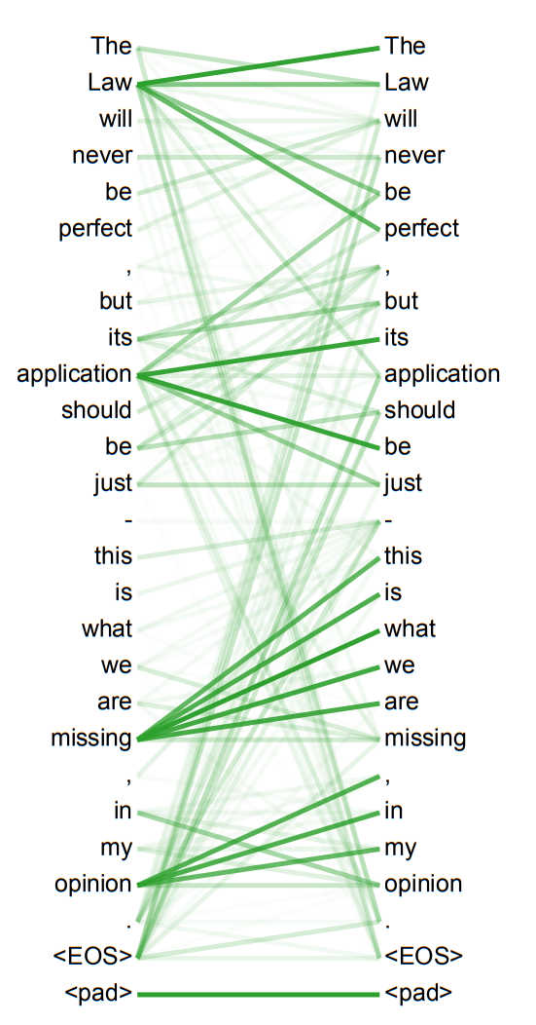
Query Key Value when it’s « against itself »
Notes:
Annexe du papier

Slide 28
Attention is all you need
Notes:
The encoder asks itself stuff and discovers interesting key value pairs.
The decoder builds queries to itself and queries to the input with the interesting key value pairs discovered.
And then the signal is dealt with with a linear layer and a softmax to determine word probabilities.

Slide 29













V1
V2
V3
V4
Notes:
V: bunch of interesting stuff
K: how you would address these things
Q: that’s the network actually addressing these things
Obviously this a 2D drawing, but it’s at a much higher dimensionality and the things are gonna be more orthogonal.
Si j’ai un texte avec une description de chats, chevaux, chiens et une description de différents types de nourriture et que ma question c’est « Que mange les chiens » ? Q va être collinéaire à chiens et nourriture mais pas à chats ni à chevaux. C’est TRES simplifié au niveau de l’humain ce que je raconte.

Slide 30
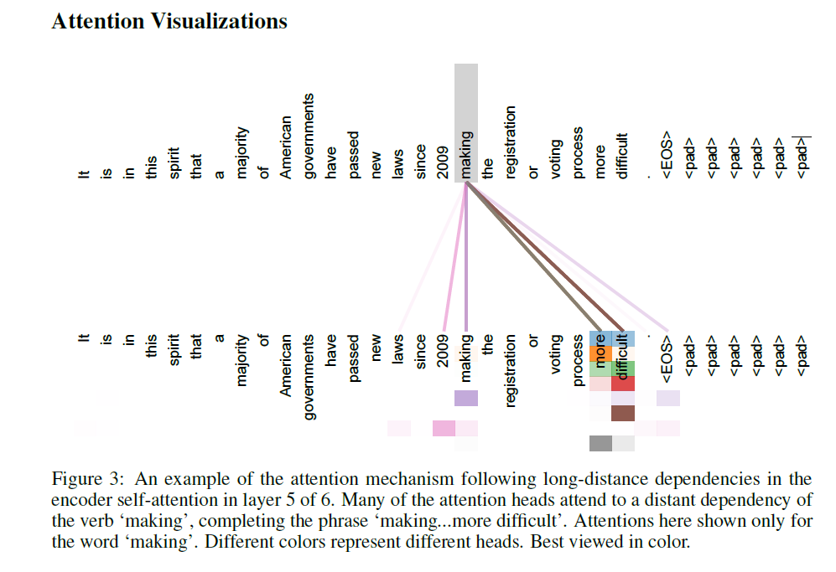




Attention is all you need

Slide 31
Attention is all you need
1. The cat sat on the mat.
2. The quick brown fox jumped over the lazy dog.
3. The sun is shining.
4. I like pizza.
5. In the beginning, God created the heavens and the earth.
1. [CLS] the cat sat on the mat [SEP]
2. [CLS] the quick brown fox jumped over the lazy dog [SEP]
3. [CLS] the sun is shining [SEP]
4. [CLS] i like pizza [SEP]
5. [CLS] in the beginning, god created the heavens and the earth [SEP]
1. [CLS] the cat sat on the mat [SEP] 0 0 0 0 0
2. [CLS] the quick brown fox jumped over the lazy dog [SEP] 0 0 0 0
3. [CLS] the sun is shining [SEP] 0 0 0 0 0 0 0 0 0 0
4. [CLS] i like pizza [SEP] 0 0 0 0 0 0 0 0 0 0 0 0 0
5. [CLS] in the beginning, god created the heavens and the earth [SEP]

Slide 32

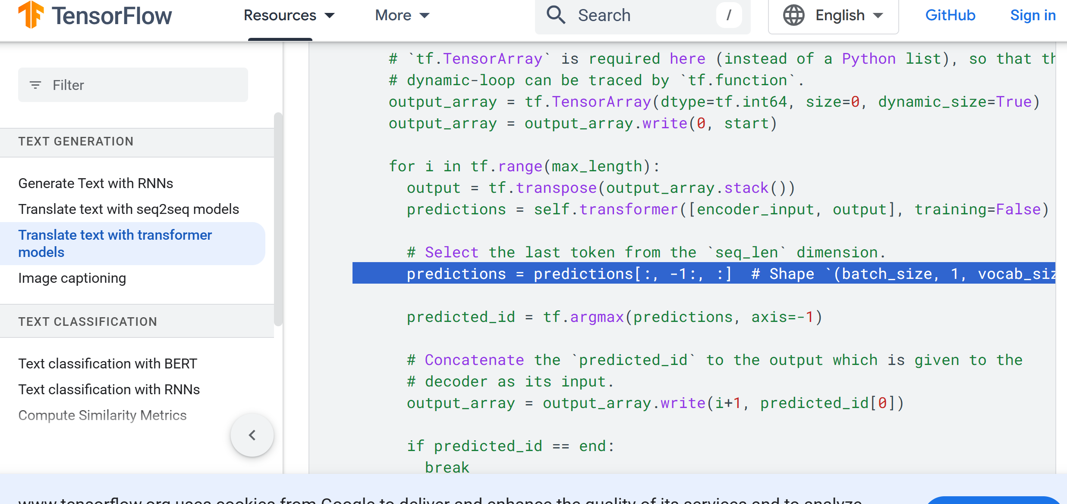
Sizes of the matrices at each step

Slide 33
Attention is all you need
"Attention is All You Need" is a paper published by Google researchers in 2017, which introduced the Transformer model for sequence-to-sequence tasks.
The paper proposes an alternative to recurrent neural networks (RNNs)
The Transformer model consists of an encoder and a decoder, both composed of stacked layers of self-attention and feedforward neural networks.
Self-attention allows the model to attend to different parts of the input sequence when predicting each output token, without requiring sequential processing.
The paper shows that the Transformer achieves state-of-the-art performance on various machine translation tasks, while being faster to train and easier to parallelize than RNN-based models.
The Transformer has since become a popular architecture for a wide range of natural language processing (NLP) tasks, such as language modeling, text classification, and question answering.
The success of the Transformer has also inspired further research into attention-based models for other domains, such as computer vision and speech recognition.
Notes:
Paper available on GitHub

Slide 34
Stable Diffusion
- Stable Diffusion is a deep learning, text-to-image model released in 2022 based on diffusion techniques.
- Diffusion models, also known as diffusion probabilistic models or score-based generative models, are a class of latent variable generative models.
- Let’s first talk about Diffusion models.
Notes:
Standard way of generating images before diffusion:
- Noise big network image (thispersondoesnotexist). The way we train this was explained by Paul last week. That kinda works, the problem is they are VERY hard to train (mode collapse). Once the generator fools the discriminator there’s no incentive in getting better. Also, noise to high resolution image in « one go » is a very optimistic view of it.
Diffusion: smaller steps, let’s not go from COMPLETE noise to NO NOISE at all.

Slide 35
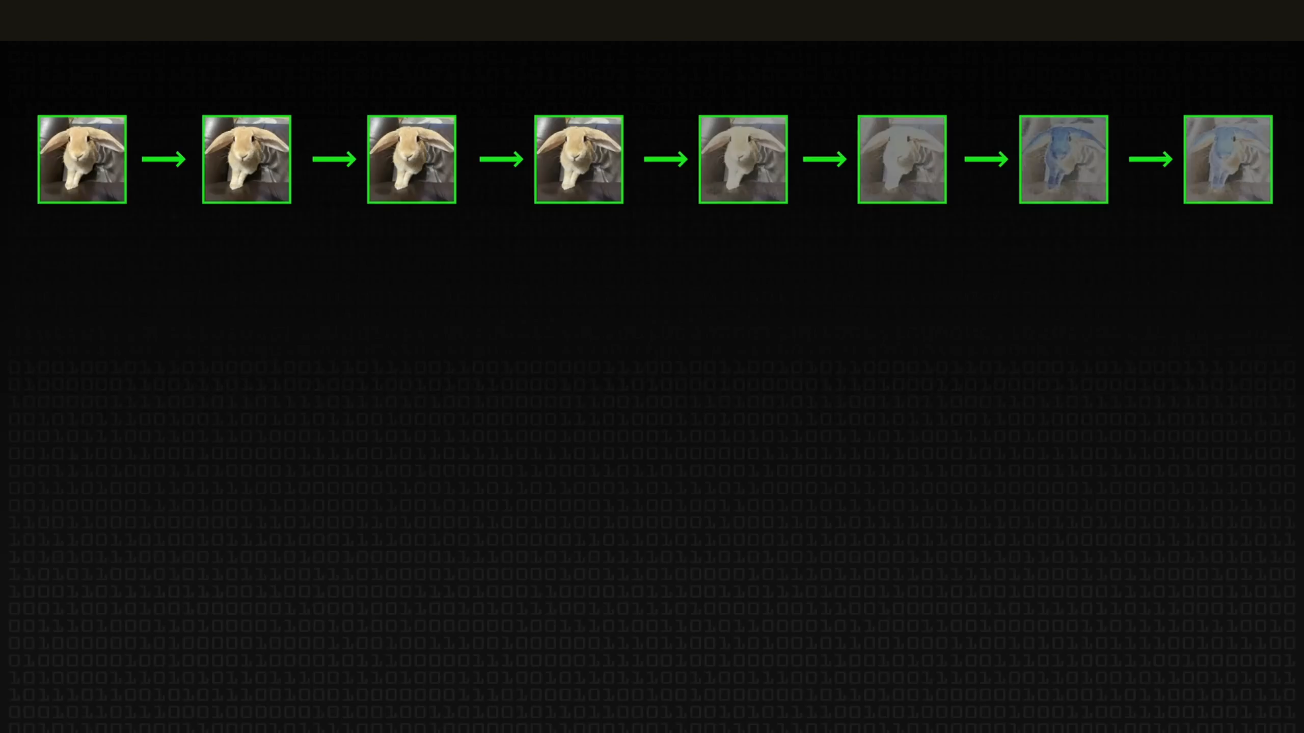
Notes:
What do we do, let’s take a rabbit and let’s add noise, up until we end up with just noise. And what we’ll do is come up with a network that undoes the noise (actually the noise is applied to a compressed low dimensional latent representation of the image). Intuition is it’s easier to go from image with some noise to original image than it is to go full on noise to image without noise. Loads of simplification here but take images (there are billions on the internet, easy). Add varying amounts of noise (easy). Train the network into predicting what to do to get the original image (in practice the network predicts what needs to be taken off the noisy image to get the original image). However, the process isn’t optimal. What we do is we do it a bit more slowly. We take the image with “n amount of noise” and we get estimate for “original image” and it won’t look too good. We then add “n-1 amount of noise” and we remove noise and get a second estimate for “original image” and it will look a tiny bit better. Each time we loop this, we get a better estimate.

Slide 36
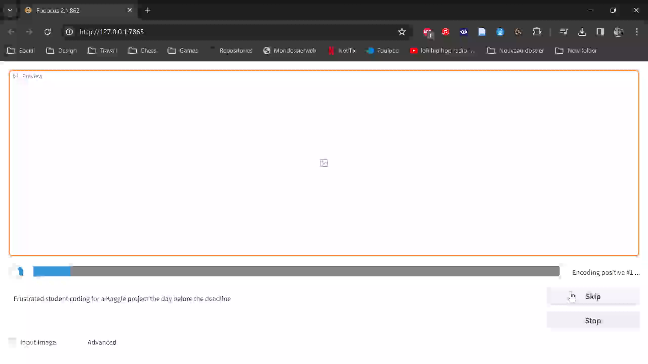
Notes:
Elephant in the room: how do we direct the image process. Up to now we generate noise, and we do 30 steps for example and we get an image. But at no point did we specify I want a « Frustrated student coding for a Kaggle project the day before the deadline ». We just feed the text on top of of feeding the noise image and then on top of feeding the slightly less noisy image etc … The process you see in this (long) video is that for loop! Actually what they do is they take the same image, add the text once and the other time don’t add the text. (but starting with the same noise). It produces twice the noise to remove, amplify the difference between the version with text and the version without.

